Slide 1

SIR MV INSTITUTE OF TECHNOLOGY DEPARTMENT OF COMPUTER SCIENCE AND ENGINEERING
An Internship Presentation
On
“Data Science”
PRESENTED BY
Sathvik N G 1MV21CS091
UNDER THE GUIDANCE OF
Internal Guide External Guide Internship Coordinator HOD
Guide Name Guide Name Prof. Dr. T N ANITHA
Designation Designation ASSISTANT PROFESSOR PROF. AND HOD
CompanyName, CSE,SIRMVIT CSE, SIRMVIT,
Place

Slide 2
CONTENTS
Company profile
Abstract
Introduction and Problem Statement
System requirements and specification
Dataset Overview
Life Cycle of a Data Science Project
Data Pre-processing and EDA
Linear Regression
Prediction and Deployment
Screen shots
Conclusion
References

Slide 3
COMPANY PROFILE

Slide 4
ABSTRACT

Slide 5
INTRODUCTION

Slide 6
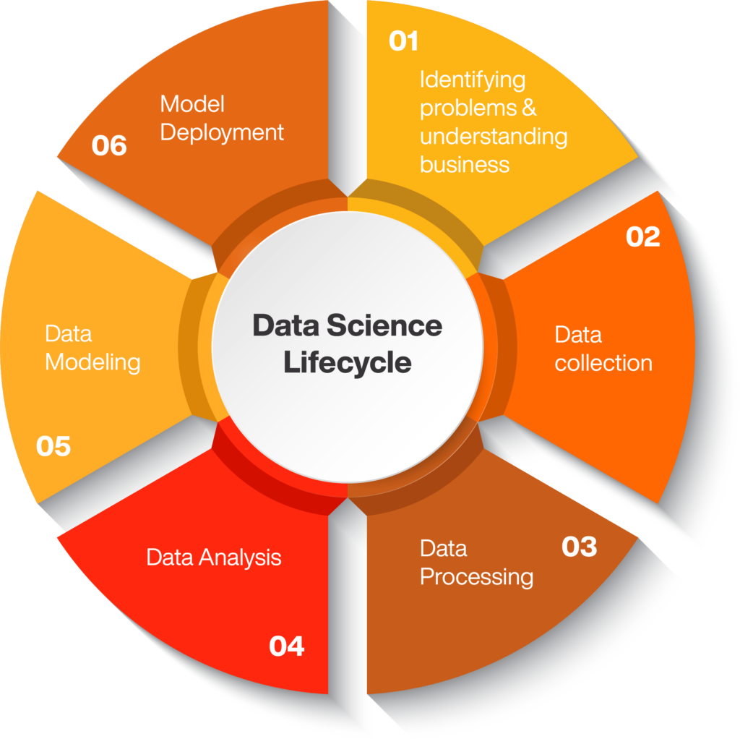
SYSTEM REQUIREMENT AND SPECIFICATION

Slide 7
DATASET OVERVIEW

Slide 8
SYSTEM REQUIREMENT AND SPECIFICATION

Slide 9
MODULES

Slide 10
SYSTEM ARCHITECTURE

Slide 11
SCREEN SHOTS

Slide 12
CONCLUSION

Slide 13
REFRENCES

Slide 14
THANK YOU

